Slide 1
Networking Fundamentals
Foundations of Ethernet and IP

Slide 2
Class of Service
#
Layer 2 Traffic Differentiation

Slide 3
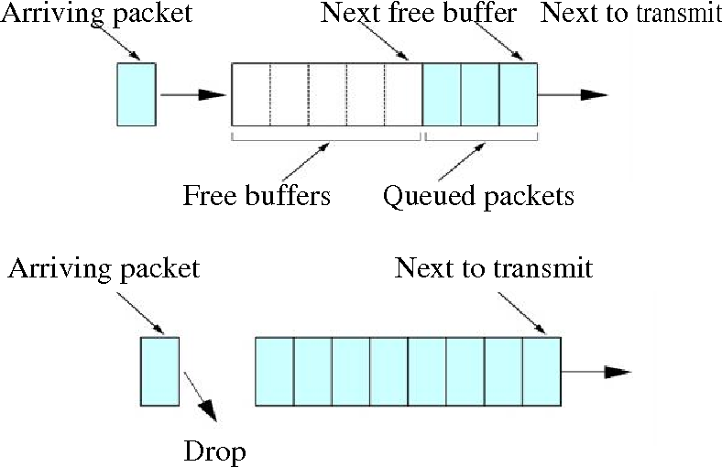
All Traffic Is Not Equal
Some traffic streams are more critical to a business than others
For example, database transactions are more important than surfing Facebook
During times of network congestion, we need to prioritize our traffic
If traffic is not prioritized, it will be dropped in an unpredictable fashion

Slide 4
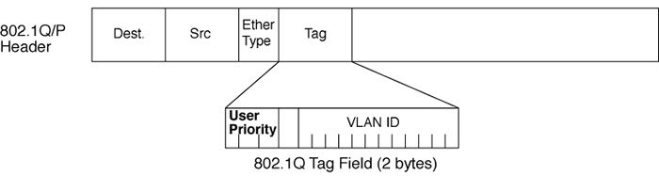
Class of Service
802.1Q header provides User Priority
3 bit CoS field – decimal 0-7
Classifies traffic to differentiate importance

Slide 5
CoS Values
Priority values can be mapped any way we want
This is the standard classification suggestion
Priority Value | Queue / Classification
Priority 0 | Background
Priority 1 | Best Effort
Priority 2 | Excellent Effort
Priority 3 | Critical Applications
Priority 4 | Video
Priority 5 | Voice
Priority 6 | Internetwork Control
Priority 7 | Network Control

Slide 6
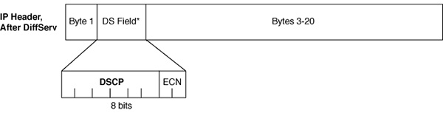
CoS vs. QoS?
Quality of Service (DSCP)
Layer 3 differentiated services field
6 bit field
In IP header
Class of Service (CoS)
Layer 2 traffic classification
3 bit field
In 802.1Q/P header

